Slide 1
Roll call
Anthony DiFalco & Eric Biscocho

Slide 2
Value Proposition
General surveillance
Home security
Public safety
Real time location updates
Entertainment
Healthcare

Slide 3
Target Markets
Governmental Agencies
Policing forces
Travel Safety Authority
Prosecutors
Enterprise Customers
Entertainment Industry
Healthcare practice owners
Civilian Customers
Security system owners
Non-security system owners

Slide 4
Revenue Stream
Initial purchase of unit
Software package subscription:
Freemium
Home Premium
Enterprise
Standard
Premium

Slide 5
Costs
Minimal viable product software costs
Continuous software improvement
Hardware costs
Raspberry pi $20
Camera $15

Slide 6
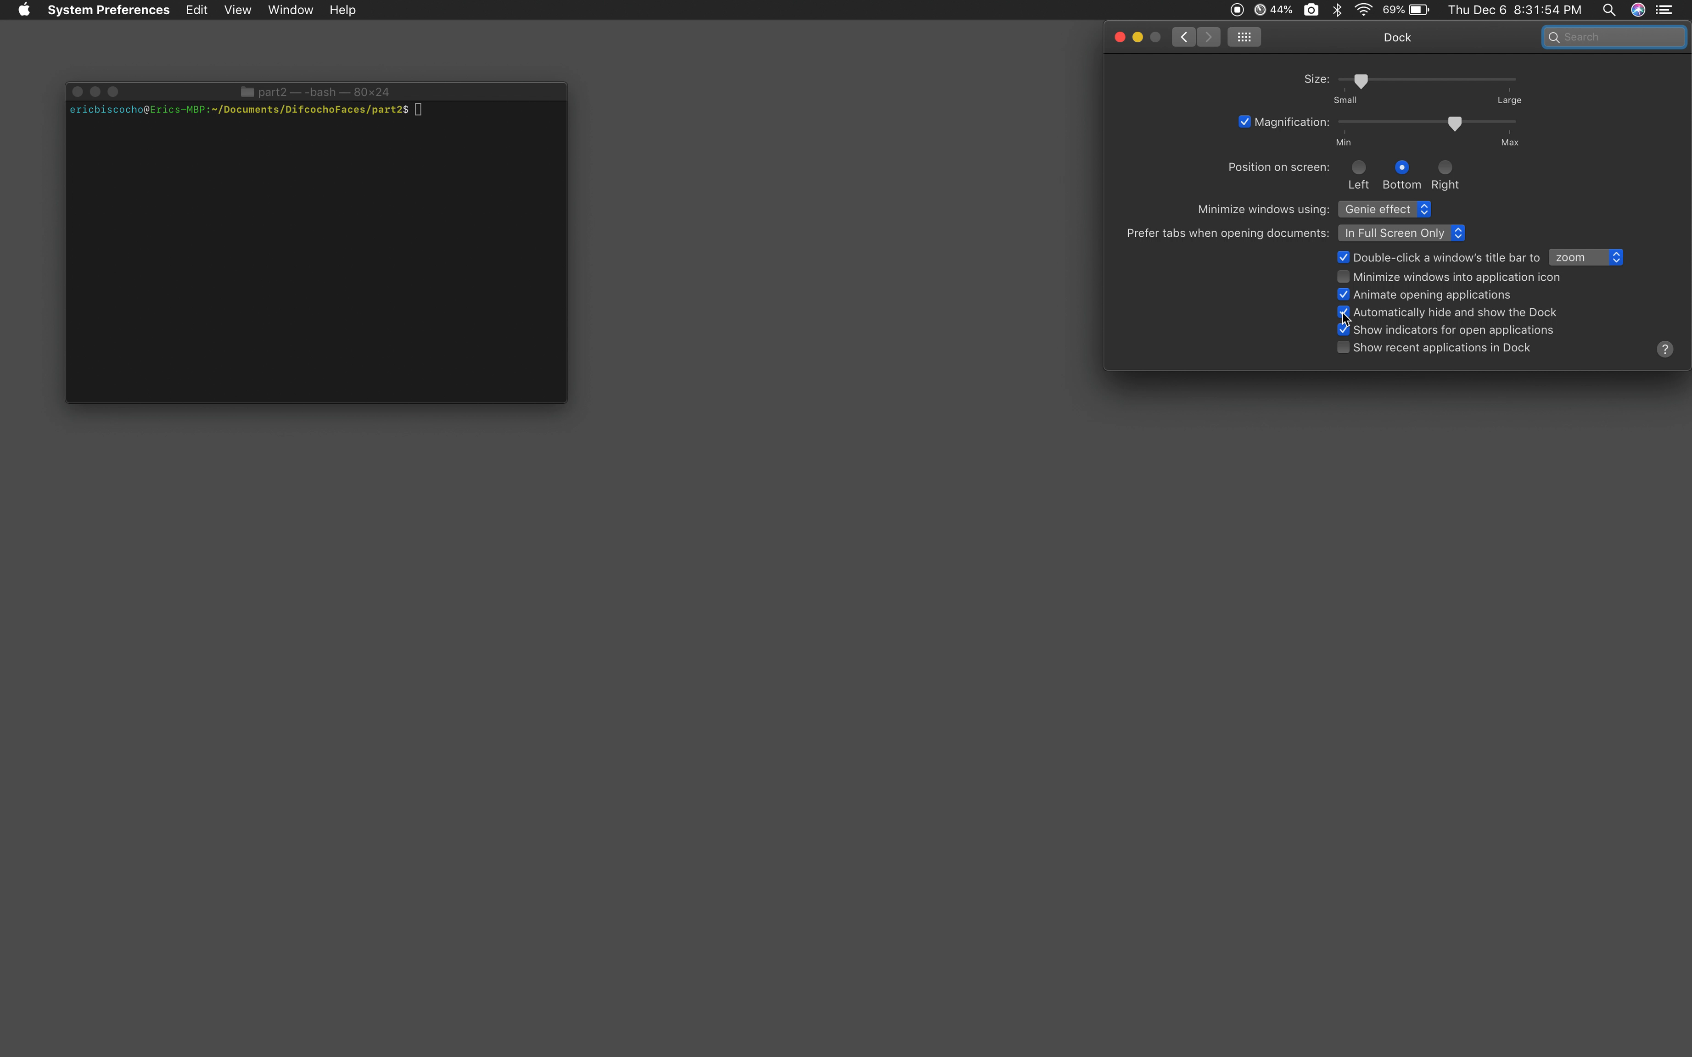
Proof of Concept Software Demo

